Slide 1
CSS In React
Regular CSS File : If you import a CSS file in React (like App.css), those styles are global by default.
CSS Modules: Lets you scope CSS to a component (no global conflicts).
Inline CSS: You use the style prop, which takes a JavaScript object (not a string).

Slide 2
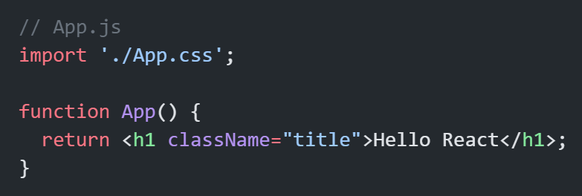
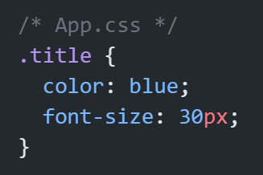
Regular CSS File

Slide 3
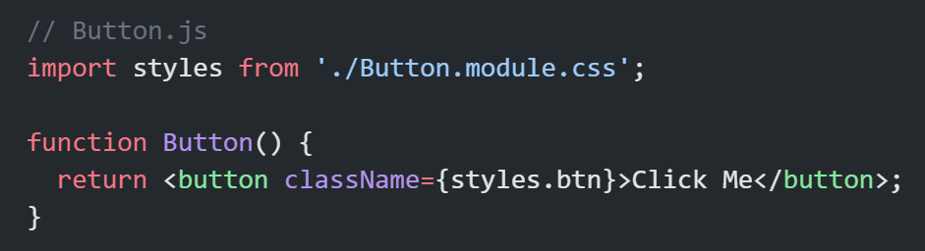
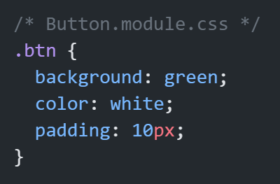
CSS Modules:

Slide 4
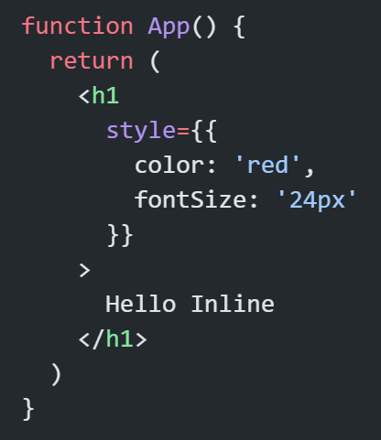
Inline CSS:

